Slide 1
Human Value Detection
A brief summary of simple neural networks and transformer architectures
Vincenzo Collura, Gianmarco Pappacoda and Anthea Silvia Sasdelli
NLP Project 2022-23 @ UniBO

Slide 2
Introduction

Slide 3
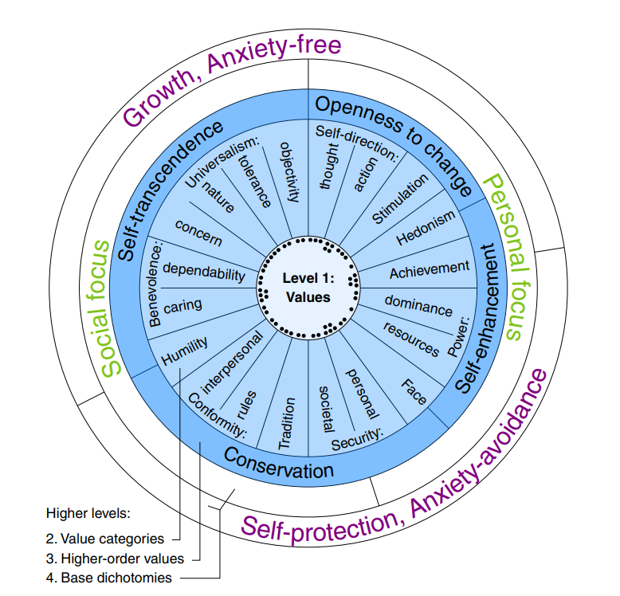
Introduction
The Human Value Detection 2023 challenge
SemEval 2023 Task 4
Identifying the Human Values behind Arguments
– Kiesel et. al 2022
Schwartz categories: what is a «human value»?
Human values are “trans-situational goals(...) that serve as guiding principles in the life of a person or group”
– Schwartz et al. 2012
Why is it important?
Values are ubiquitous
Politics, companies
Our approach
GloVe + Simple neural networks
LLM (transformers) fine-tuning

Slide 4
Dataset

Slide 5
Dataset
7289 records
at a glance
Argument ID | Conclusion | Stance | Premise
A20223 | We should ban algorithmic trading | against | algorithmic trading allows computers to make p...
A23471 | We should legalize prostitution | in favor of | some women have no other way to support themse...
E07094 | We need a better distribution of refugees. | against | If you want migrants, invite them into your home.
A07060 | We should legalize organ trade | in favor of | Organ sales increase the likelihood that peopl...
A30056 | We should limit judicial activism | against | we should not limit judicial activism because ...
+20 Non-mutually exclusive Level 2 value labels
Train/Test split = 0.85
Identifying the Human Values behind Arguments – Kiesel et. al 2022
The provided test set was not labeled, so part of the training set was used instead.
But (!)
The dataset was unbalanced!!

Slide 6
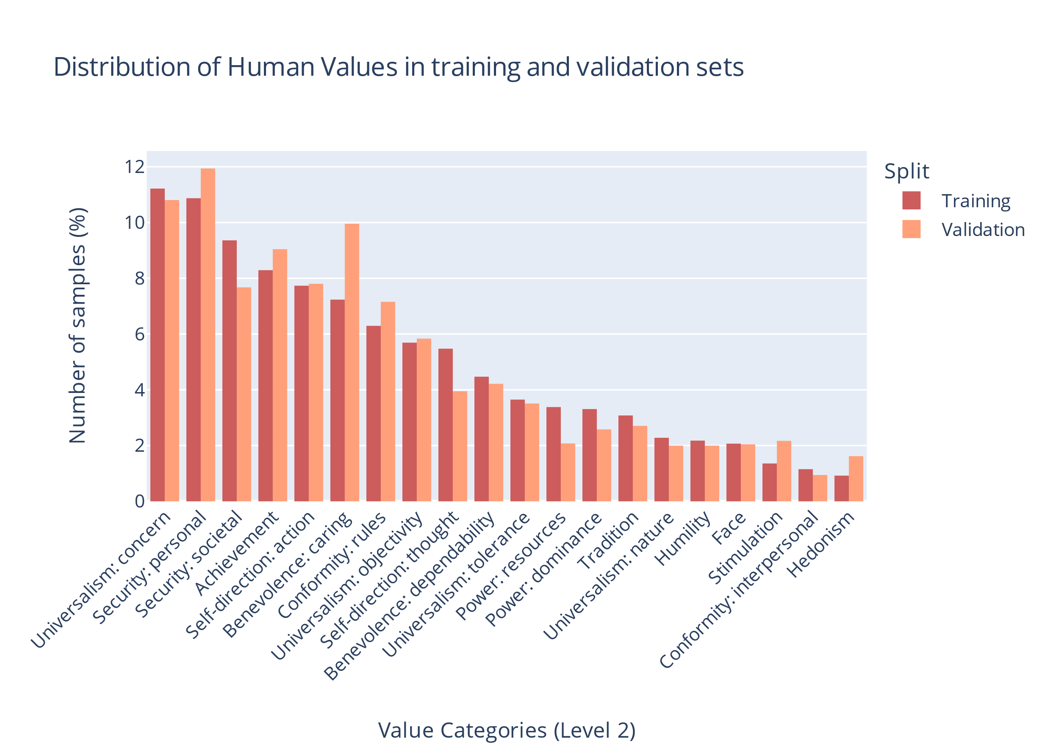
Dataset unbalanced

Slide 7

A bit of preprocessing
Stance
Conclusion
Premise
2.
Stance
Conclusion
Premise
Argument ID | Conclusion | Stance | Premise
A20223 | We should ban algorithmic trading | against | algorithmic trading allows computers to make p...
1. Stance ← ‘favor’ || ‘against’
Simpler Architectures:
GloVe for the embedding
Transformers:
own embeddings
No punctuation
Lowercasing
OOV words checking
3.

Slide 8
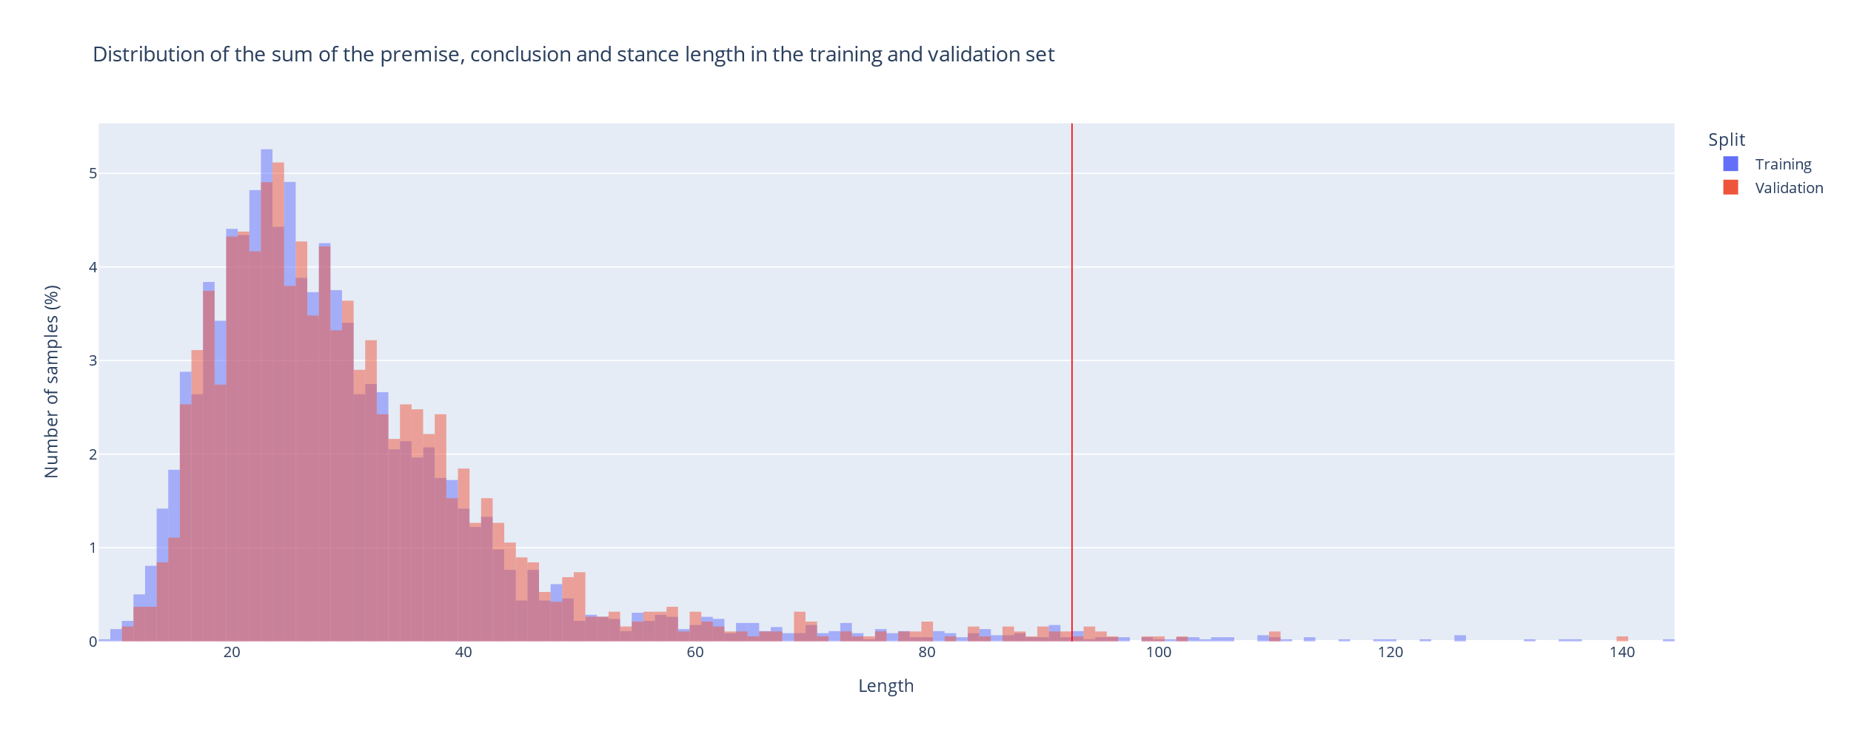
Maximum Sequence Length

Slide 9
Methodology
&
Experimental setup

Slide 10
Methodology
Reproducibility
Train/Test split
Validation
Seed=42
Enforced on/by libraries
0.85
Early Stopping
Taking best model according to val_loss
Simple architectures
Transformers
Error analysis
GloVe + Bidirectional LSTM
GloVe + Convolutional NN
Bert-Tiny
DistlRoBERTa-base
Quantitative
Qualitative

Slide 11
Methodology
Reproducibility
Train/Test split
Validation
Seed=42
Enforced on/by libraries
0,85
Early Stopping
Taking best model according to val_loss
Simple architectures
Transformers
Error analysis
GloVe + Bidirectional LSTM
Bert-Tiny
Quantitative
GloVe + Convolutional NN
DistlRoBERTa-base
Qualitative

Slide 12

Simple Architectures

Slide 13
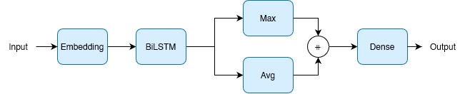
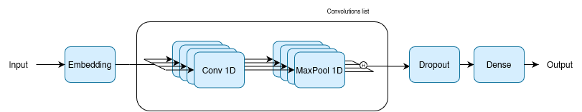
Simple architectures
BiLSTM Model
CNNText Model

Slide 14

Transformers
RIPOFF

Slide 15
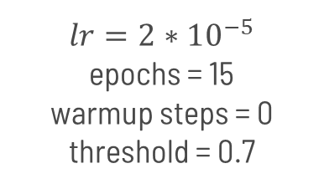
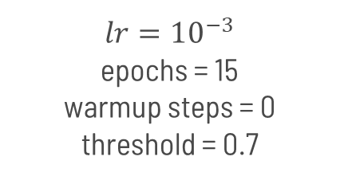
Transformers
About weights
Hyperparameters
Preprocessing
Frozen = Less performant
Unfrozen = Better performance, risk overfit
Learning rate
N. Epochs
Warmup steps
Threshold
Same as simple models
Each model has its own embeddings
Thresholding
Bert-Tiny
DistilRoBERTa-base
Output -> Logits
Use sigmoid
Set a thrshold
$$lr={10}^{−3}$$
epochs = 15
warmup steps = 0
threshold = 0.7
$$lr={2∗10}^{−5}$$
epochs = 15
warmup steps = 0
threshold = 0.7

Slide 16
Results

Slide 17
Results: overall

Slide 18
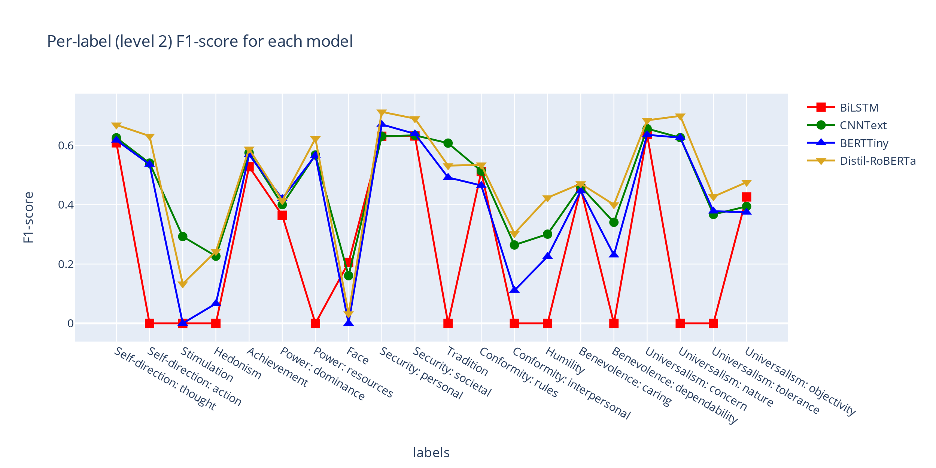
Results: per-label (test)

Slide 19
Some interesting examples (Face)
Stance | Conclusion | Premise | Face | CNN | BiLSTM | T-bert | D-roberta
against | We should cancel pride parades | pride parades are a necessary step towards bringing awareness to the world that all human beings deserve respect and acceptance. | 1 | 1 | 1 | 0 | 1
against | We should cancel pride parades | people have the right to express themselves. | 1 | 1 | 1 | 0 | 0
against | We should cancel pride parades | pride parades offer a sense of community and support. | 0 | 1 | 1 | 0 | 0
in favor of | We should adopt gender-neutral language | With genders now being more equal than ever, and gender neutrality growing exponentially the old gendered language is just a historic anachronism. | 1 | 0 | 0 | 0 | 0
in favor of | We should legalize prostitution | We should legalize prostitution in order to avoid giving young people criminal records that will hurt their job prospects down the line. | 1 | 0 | 0 | 0 | 0
in favor of | We should abolish the Olympic Games | we should abolish the olympic games because it is inhumane to have people compete for profit or gain. | 1 | 0 | 0 | 0 | 0
against | We should ban cosmetic surgery for minors | we should not ban cosmetic surgery for minors as they may be suffering from bulling because of this problem that could be solved with surgery. | 1 | 0 | 0 | 0 | 0
against | We should ban cosmetic surgery | some severe birth defect can be fixed by cosmetic surgery and these people have a right to live their life without the stigma of their disformity tormenting them for their entire life. | 1 | 0 | 0 | 0 | 0
It is good to maintain one's public image, have social recognition, have a good reputation.

Slide 20
The «winner» is
Roberta!

Slide 21
Conclusions
&
Future improvements

Slide 22
Conclusions
Word embeddings
Are good
Better unfrozen
Simpler models
Transformers
Worked well…
…but are less general
CNNText was second-best
Best performance
Good generalization
Easy overfitting
DistilRoBERTA could be trained more
Future improvements
More data (?)
Hyperparameter-tuning
Quadratic attention-less

Slide 23
Thank you!
For your attention

Slide 24

Questions ?

